Slide 1
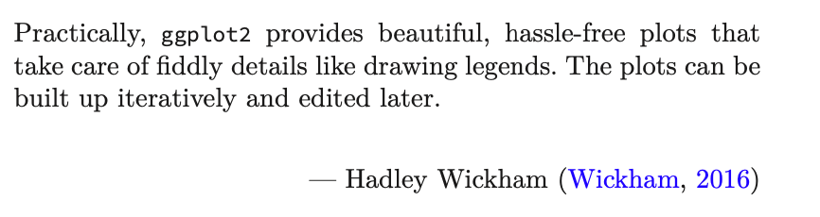
Exploring Operations Research with R: A Workshop
05 – Operations Research Examples
https://github.com/JimDuggan/Exploring-OR-with-R-Workshop

Slide 2
Topics Overview
Topic | Description | ~Timing
1 | Introduction to R and Posit Cloud | 10 mins
2 | Storing data using data frames / tibbles | 10 mins
3 | Visualisation with ggplot2 | 20 mins
4 | Data transformation with dplyr | 20 mins
5 | Using R with OR – Four Examples | 30 mins
Example | Description
1 | Exploratory Data Analysis
2 | Linear Programming
3 | Agent Based Simulation
4 | Data transformation with dplyr

Slide 3
(1) Exploratory Data Analysis
“Exploratory analysis is what you do to understand the data and figure out what might be noteworthy or interesting to highlight to others. When we do exploratory analysis, it’s like hunting for pearls in oysters.”
Cole Nussbaumer Knaflic (Knaflic, 2015)

Slide 4
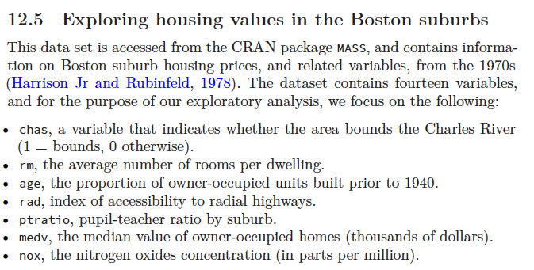
CRAN package MASS, Boston Data Set

Slide 5
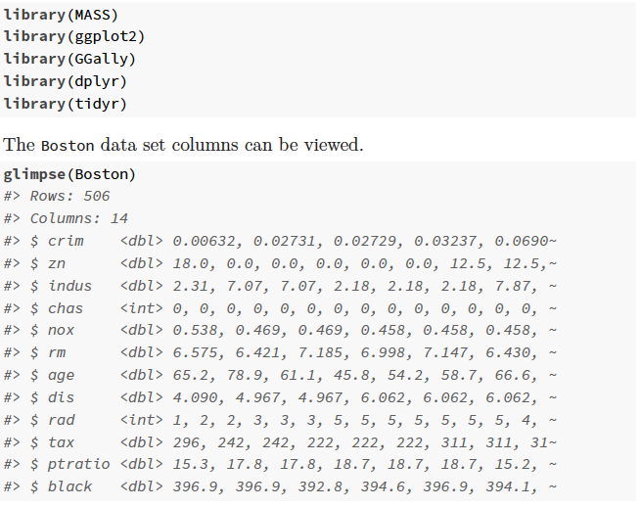

Slide 6
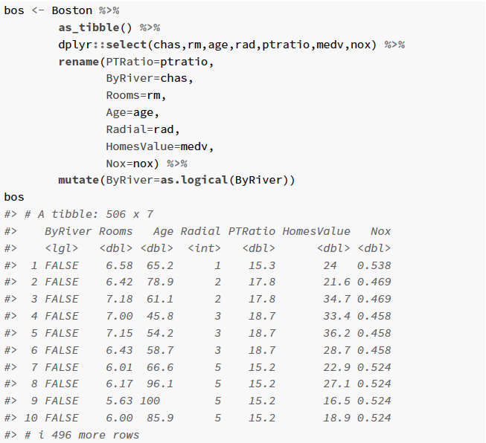

Slide 7
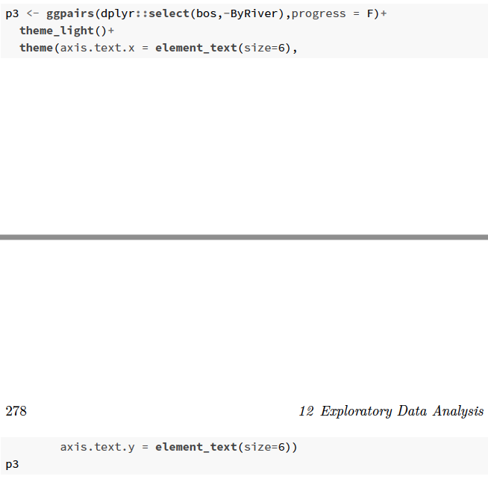
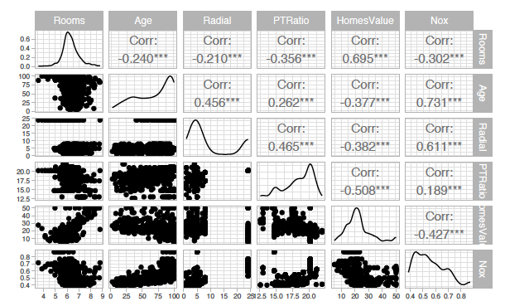

Slide 8
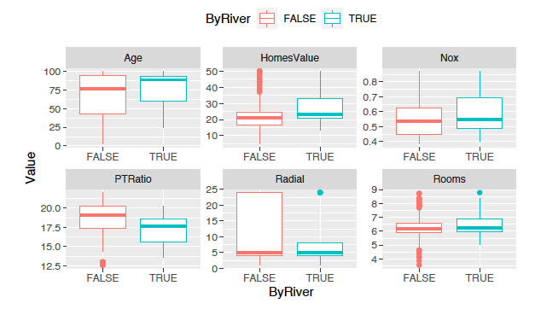
Additional analysis (Needs tidyr)

Slide 9
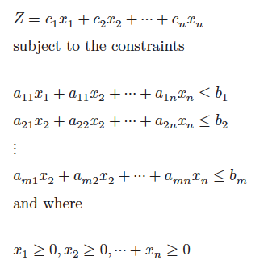
(2) Linear Programming
“The success of an OR technique is ultimately measured by the spread of its use as a decision making tool. Ever since in introduction in the late 1940s, linear programming (LP) has proven to be one of the most effective operations research tools.”
Hamdy A. Taha (Taha, 1992)

Slide 10
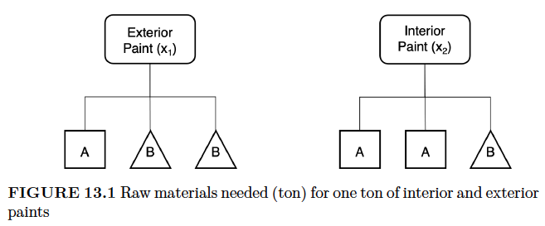
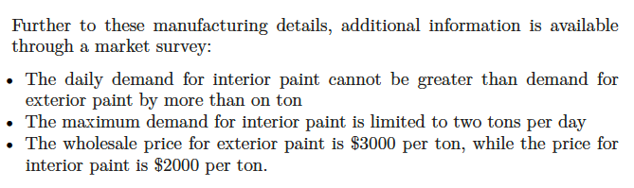
The Reddy Mikks example (Taha 1995)

Slide 11
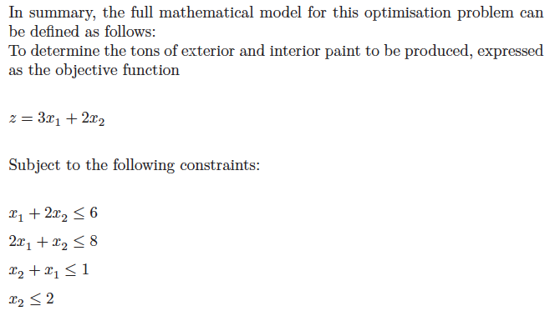
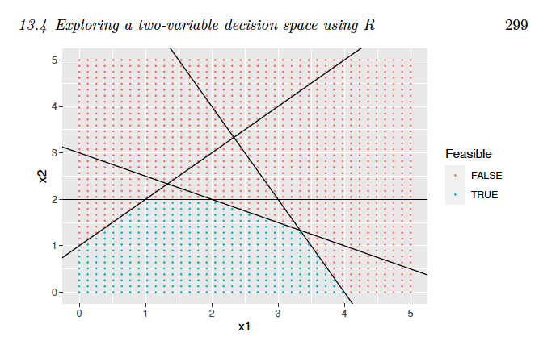
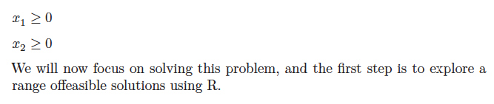

Slide 12
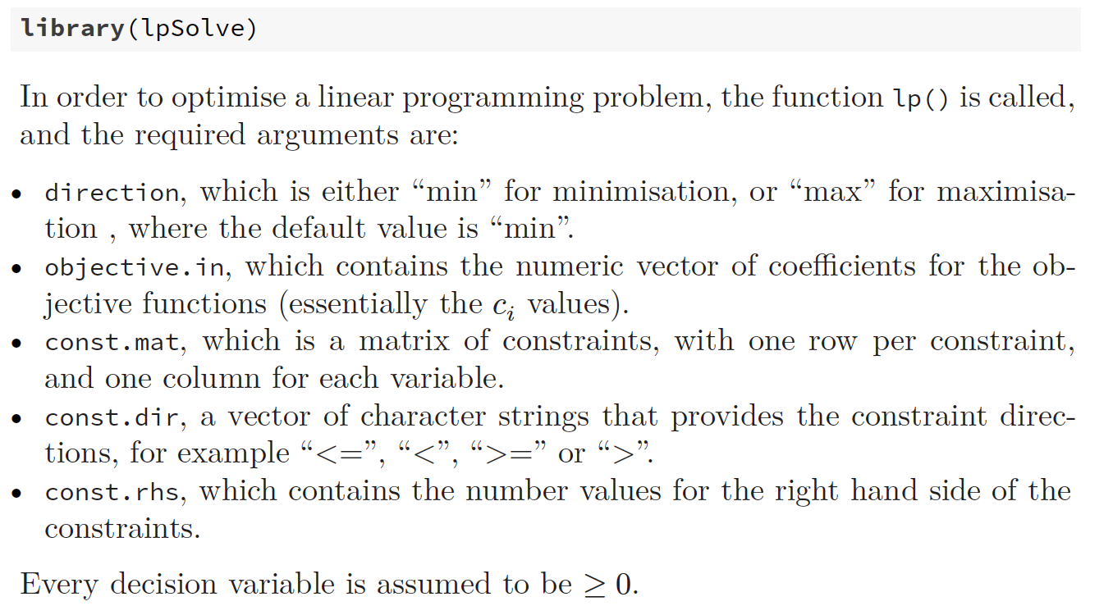

Slide 13
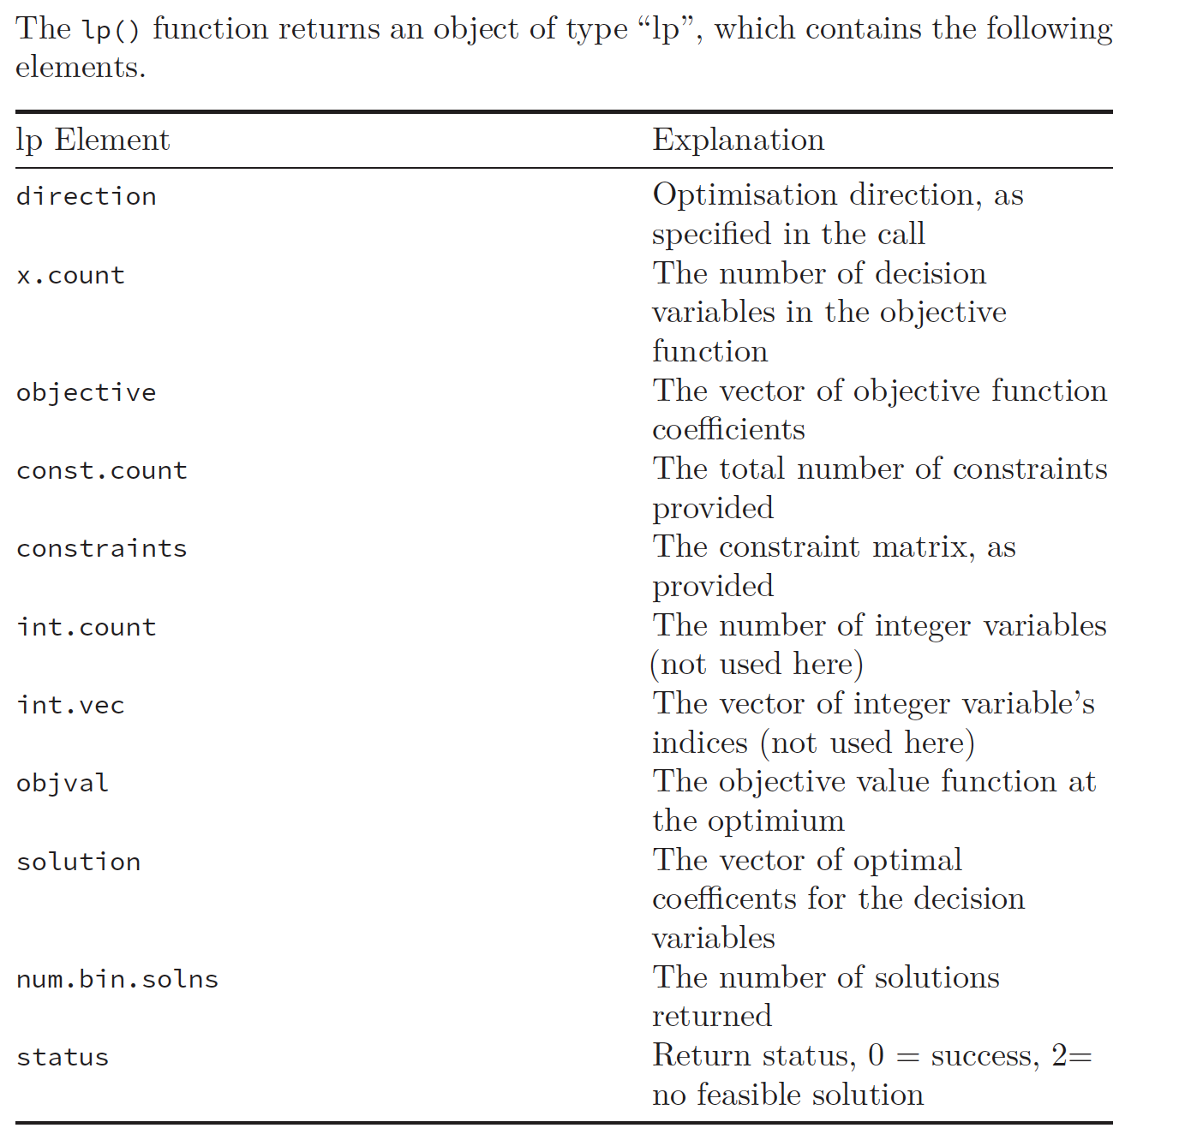

Slide 14
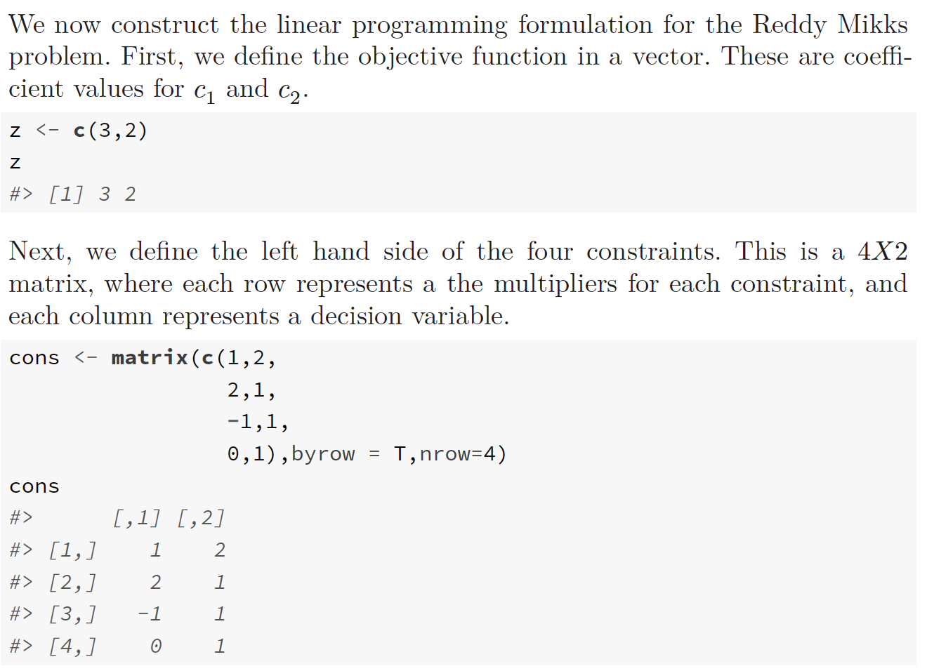

Slide 15
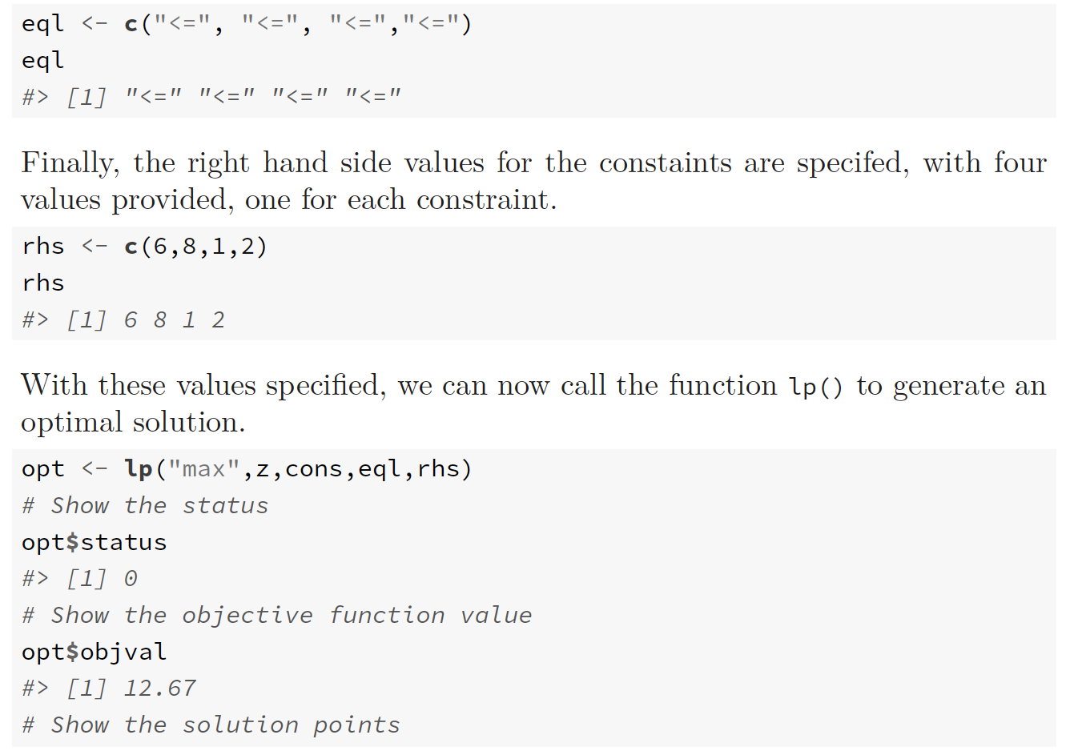

Slide 16
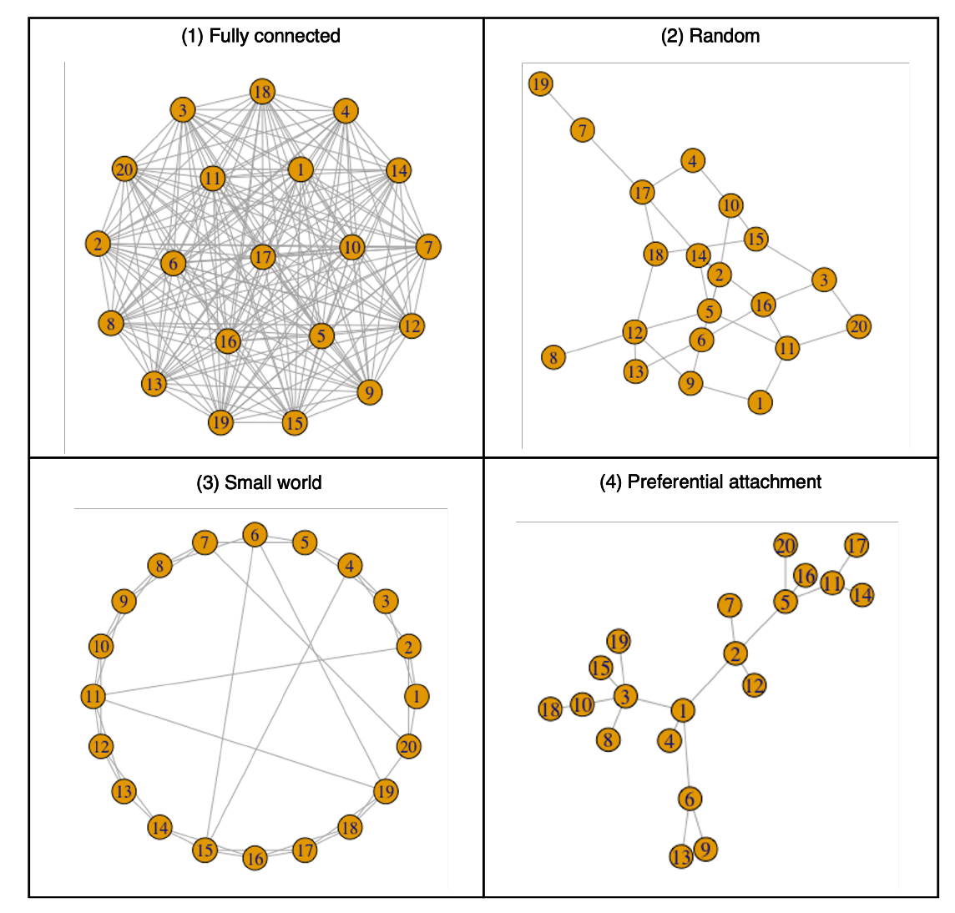
(3) Agent Based Simulation
Situate an initial population of autonomous heterogeneous agents in a relevant spatial environment; allow them to interact according to simple local rules, and thereby generate – or “grow” - the macroscopic regularity from the bottom up.
Joshua M. Epstein (Epstein, 2012)

Slide 17
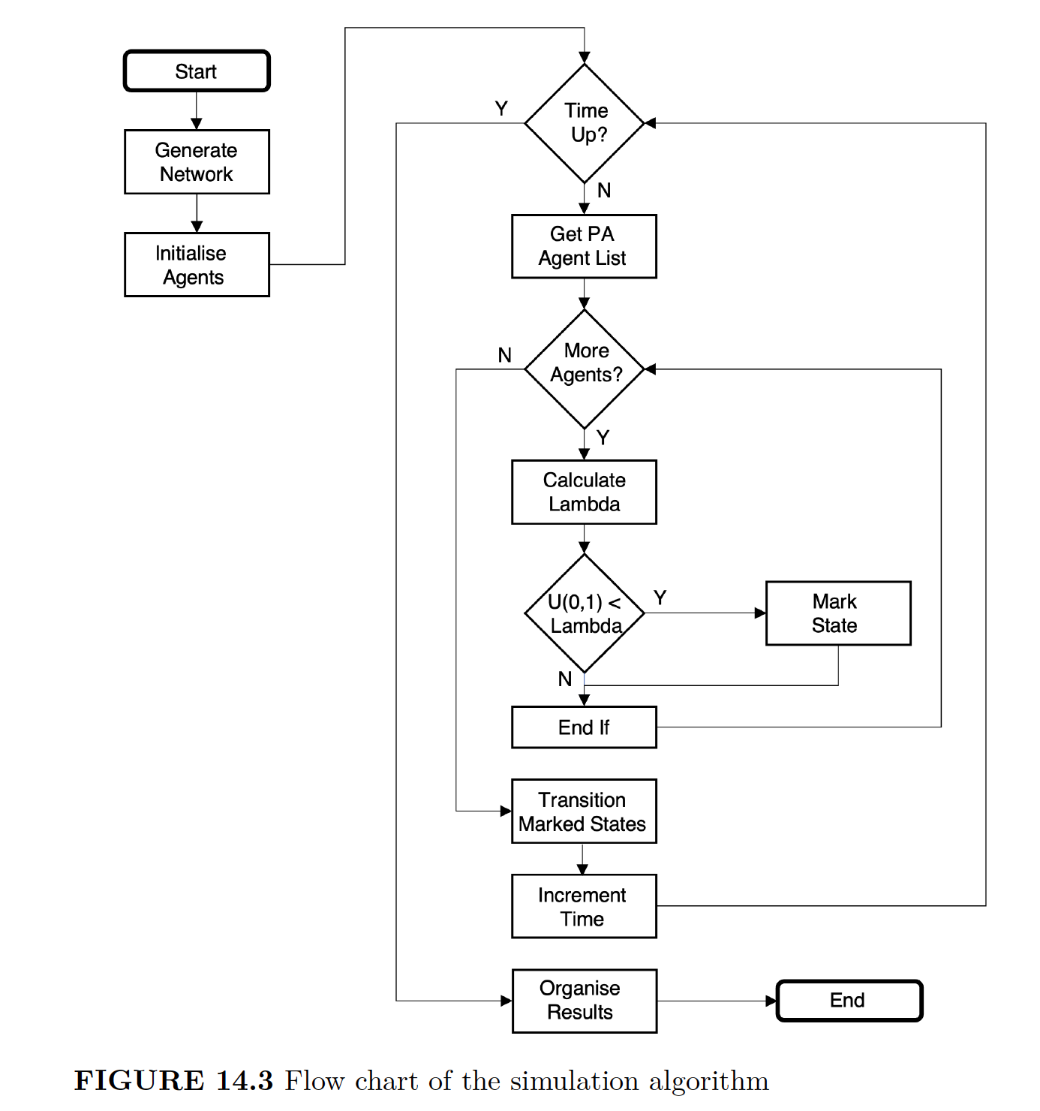
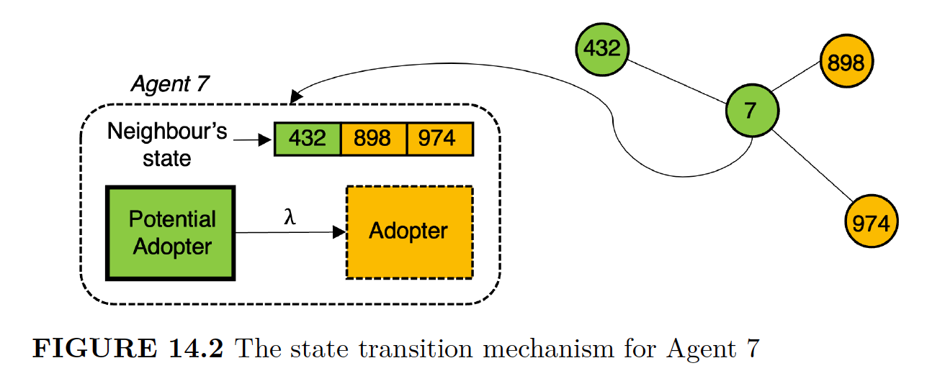

Slide 18
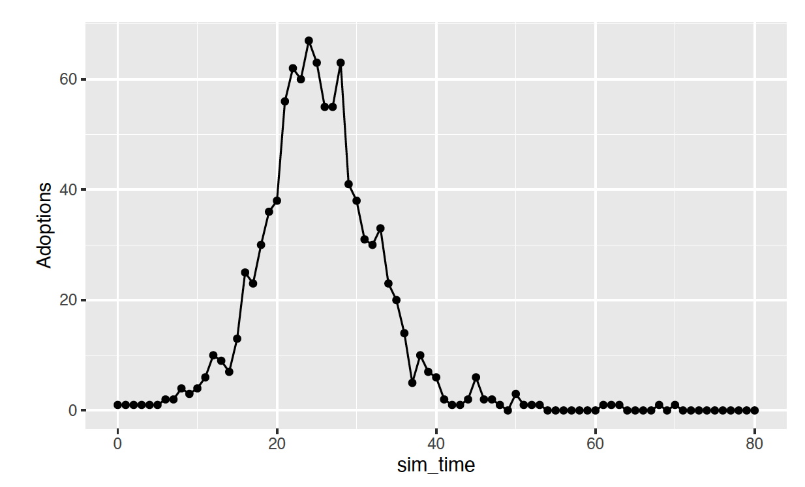
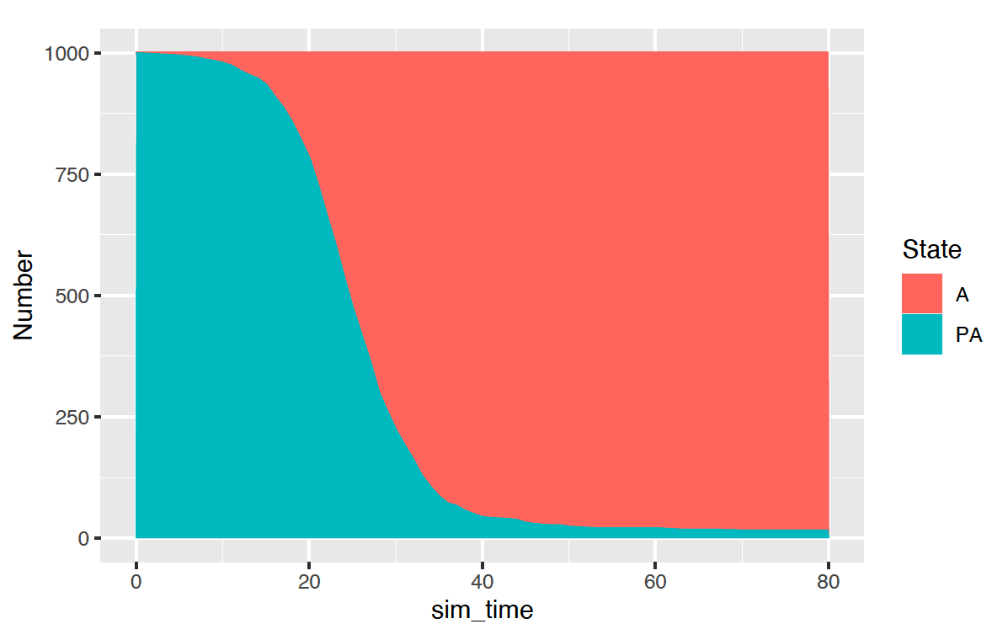
A single run…

Slide 19
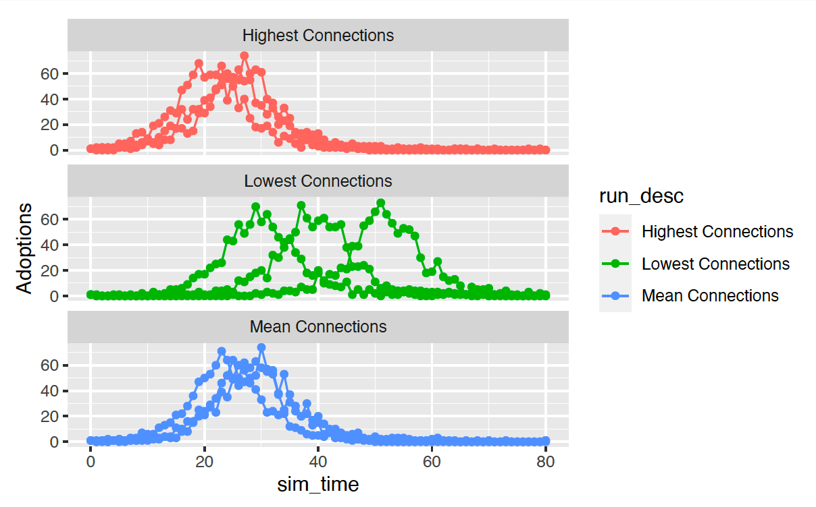
Three Scenarios (Different seeded individual)

Slide 20
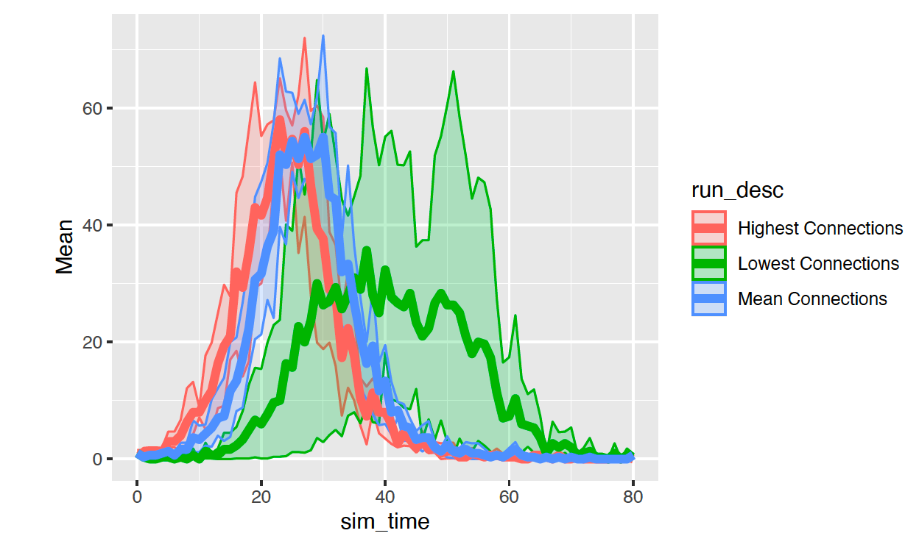
Quantile analysis

Slide 21
(4) System Dynamics
Situate an initial population of autonomous heterogeneous agents in a relevant spatial environment; allow them to interact according to simple local rules, and thereby generate – or “grow” - the macroscopic regularity from the bottom up.
Joshua M. Epstein (Epstein, 2012)

